Slide 1
Dairy Shop
Sales Analysis
Data provided by Nielsen
Gokturk Demir, Ji Hun (James) Lee, and Weihuang (Steven) Xie

Slide 2
Data Overview and Engineering
Household Data: Customer Profile
60000 x 58; e.g. income, household size, education, race, employment
Purchase Data: Purchasing data specific to each UPC
2 mil x 7; e.g. price and quantity
Product Data: Product Features
10000 x42; e.g. yogurt, cereal, etc
Trip Data: Record 1 million tractions made by 50,000 households
1,000,000 x 8; important variables: amount spent
Joining these tables for analysis
Joined via foreign key: household code, upc, trip code
Advanced analysis requires weaving multiple tables into one fabric
Analysis to be done on this dataset:
Unsupervised Learning to find clusters within household and product
Supervised Learning to find relationships among sales, price, promotion, yogurt

Slide 3
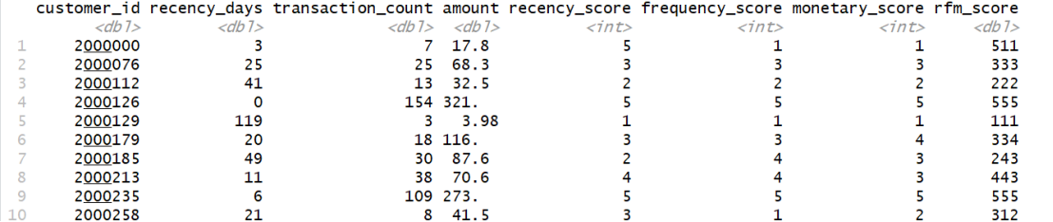
Household Segments
RFM Model --Scoring
One Problem with Data: Time frame for each customer’s transaction is different
Solution: RFM is a customer analysis model especially for purchase information:
Recency(R): How recently did the customer purchase?
Frequency(F): How often you purchase?
Monetary Value(M): How much they buy?
RFM Model Output:

Slide 4
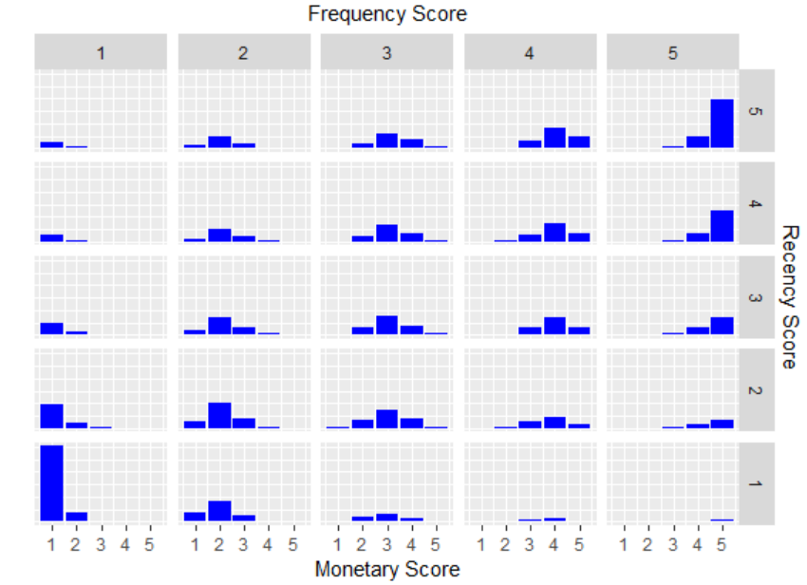
Household Segments: Data Description i
RFM Model --Overview

Slide 5
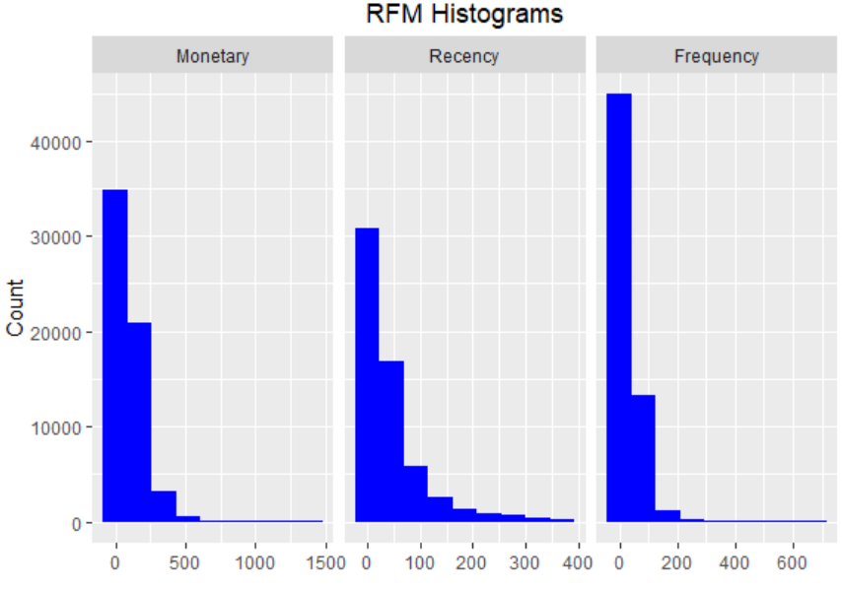
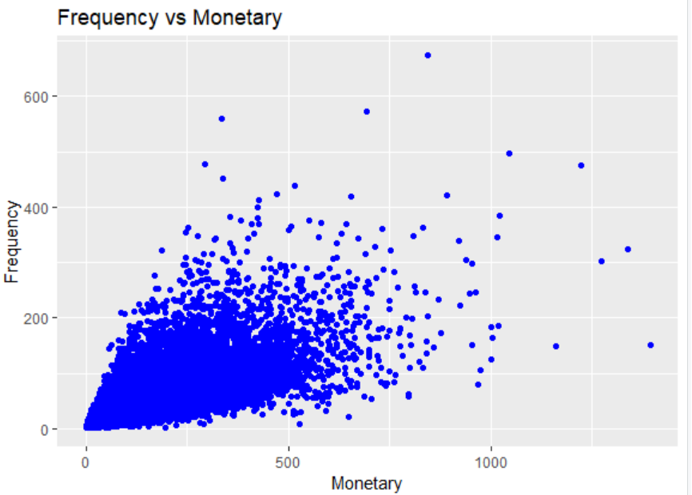
Household Segments: Data Description II
RFM Model --Overview
Frequency and Monetary tend to have positive relationship;
Most people spent 0-250 dollars; 100 times a year; within last 50 days;

Slide 6
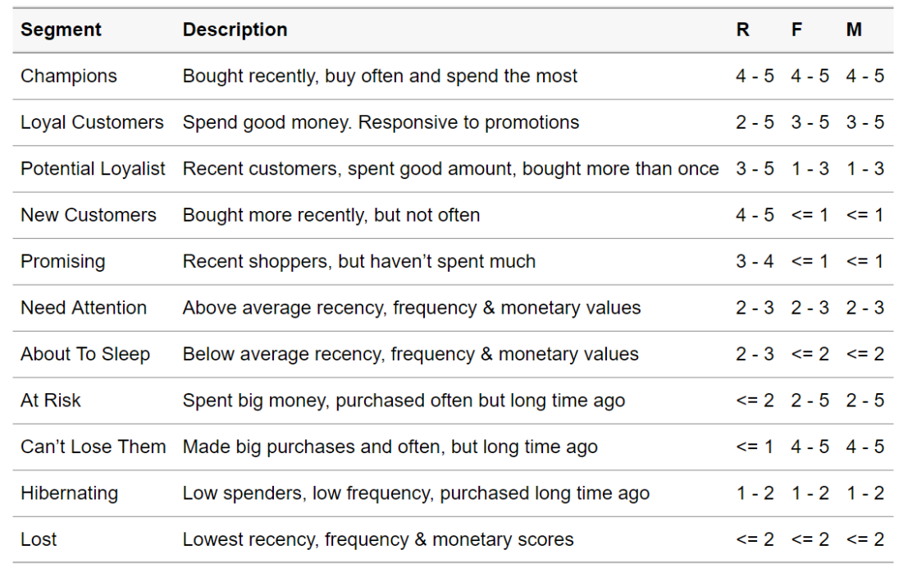
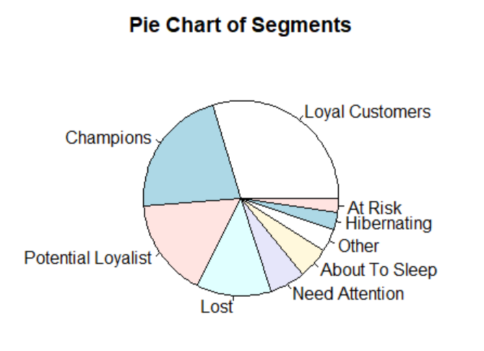
Household Segments: Segmentation
RFM Model --Segment
Champions and loyal customers are the majority; good amount of potential loyalist;
Also significant amount of lost customers
https://cran.r-project.org/web/packages/rfm/vignettes/rfm-customer-level-data.html

Slide 7
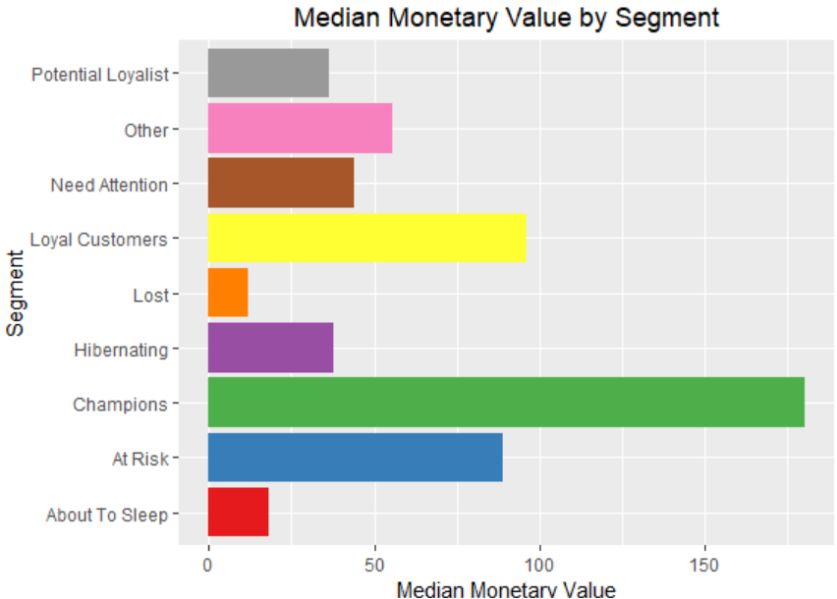
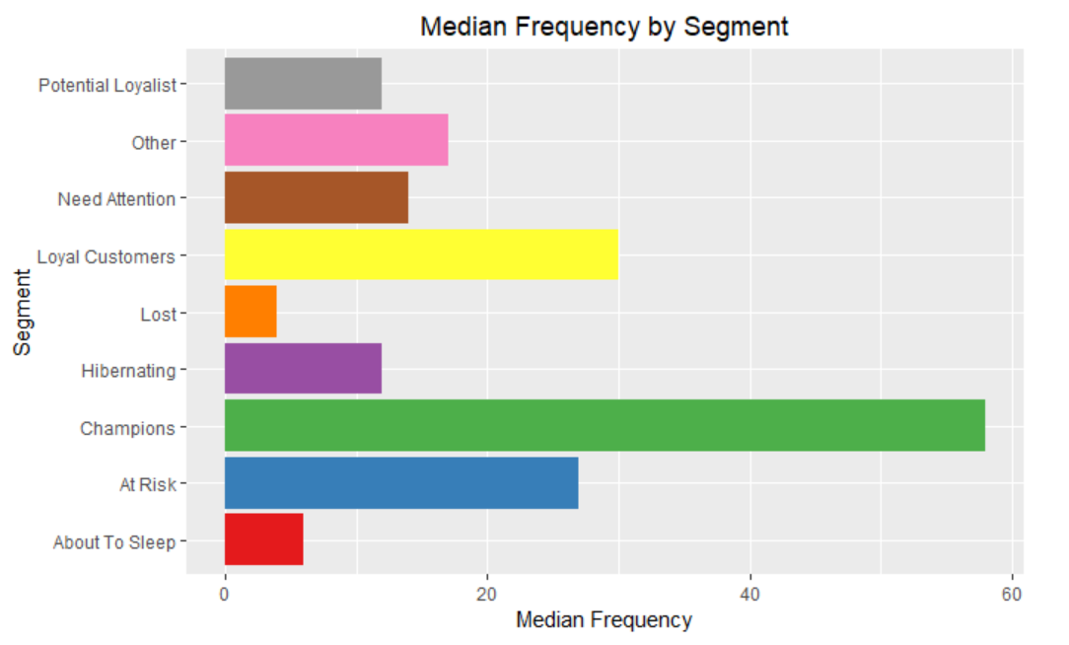
Household Segments
RFM Model --Segment Characteristics
Champions and loyal customers contribute the main sales

Slide 8
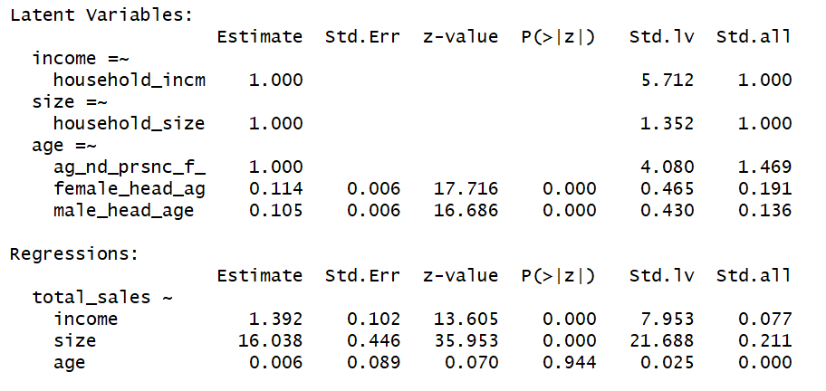
Attributes Driving Sales
(for Champions and Loyalist Segment)
SEM Model --Only Numeric Attributes(ML)
Generally, income and household size are driving the overall sales of our main customer.

Slide 9
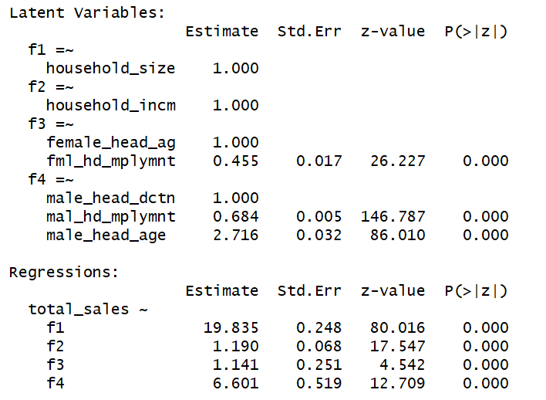
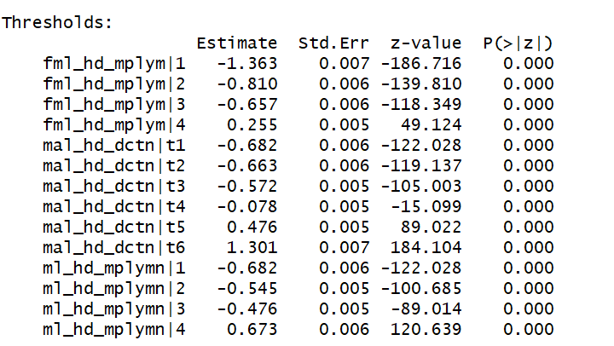
Attributes Driving Sales
SEM Model --All Attributes(DWLS)
Income, household size , female & male head status(education, employment, age) are driving the overall sales of our main customer.

Slide 10
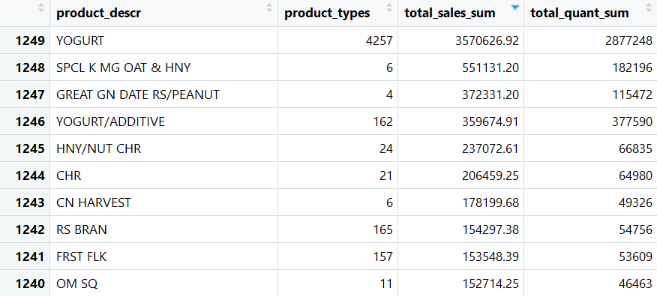
Main Products Driving Sales
We will focus on Yogurt and do more analysis specific to customer who purchase yogurt. .

Slide 11
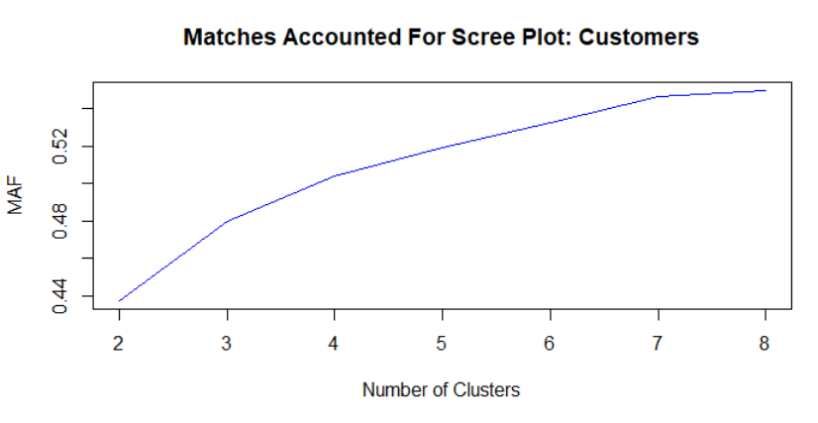
HOUSEHOLD CLUSTERING: METHODOLOGY
Segmentation of households in panelists table
All column values are categorical
Focus on top 1000 projection factor households
Use K-Modes (analogue of K-means) and LCA
Our complexity parameter: number of cluster
Validation for the number of clusters by MAF scree plot
4 Clusters!

Slide 12
HOUSEHOLD CLUSTERING: RESULT
$100 +K Annual income, no children under 18, White/Caucasian , High School Graduate, Single
$100 +K Annual income, 0-12 years old children, White/Caucasian, Some college, Married
$70-99K Annual income , no children under 18, White/Caucasian , High School Graduate, Divorced/Separated
$100 +K Annual income, no children under 18, White/Caucasian, High School Graduate, Married

Slide 13

YOGURT CLUSTERING
There are so many different types of yogurt, so we want to know the main types (=clusters)
Why are segments’ type code and style code the same?
It’s because data are predominantly regular type (not organic) and low_fat
How can we find segmentation when data is dominated by one category?
Ignore the dominant type, and then cluster the rest to find diversity among segments to avoid overgeneralization

Slide 14
Which segments are the most price sensitive to yogurt?
National/Regional Level
Daily transaction data in the whole year 2011; aggregate yogurt and non-yogurt sale data with price and quantity
Model: logsale_{t} = β₀ + β₁* logprice(yogurt_{t}) +β₂* logprice(rest_{t}) + e_{t}
Overall price sensitivity of yogurt: inelastic; coefficient = 0.6 < 1 ( national level)
More or less similar elasticities depending on the region (nine regions)
Coefficient is significant but simple linear regression is ill-fitting
Shapiro-Wilks test: short-tailed normal distribution of residuals
Residual vs Fitted value plot: heteroskedasticity - diminishing residuals as fitted values increase
Variance stabilizing transformation: box-cox transformation (lambda=0.5 for interpretation purpose)
New coefficient value: 0.4
Segment Level
Same model as national level; some segments suffer ill fit for regression
Variance stabilizing transformation
Price elasticity is the highest among the segment 3 (~.71), but not by large margin than the rest
All segments we have made are insensitive to yogurt price increases

Slide 15
Which marketing mix is the most important to sale of a general yogurt?
Segment Level: select 1000 households with the highest projection factors
Marketing Mix Aggregate: Bayesian Linear Model
Model (segments 1 through 4): MCMCregress(sale1 ~ price1 + promotion1 + region1)
Using credible interval in the Quantile Summary to interpret the “statistical significance” of coefficient to see whether the interval contains 0
Similar result obtained by OLS
Result: price and promotion significant for all segments but with varying degrees. Promotion most effective for the third segment!
Marketing Mix Household: Bayesian Hierarchical regression
Divide sale, price, promotion into intervals and make them factor variables
Hierarchical MCMC: regression on individual household
MCMChregress(fixed=sale ~ price + promotion + region,random=~price +promotion+region, group=”household_id”,r=6,R=diag(6))
“Elasticities” of sale obtained with respect to price, promotion, and region at individual level

Slide 16
Which household segments are likely to choose which type of yogurt (segment)?
Simple Model: Contingency table?
One way to answer is using conditional distribution: E.g. P(yogurt=1|household=1)
Choice modeling of yogurt segment based on household segment
Multinomial Logit Model: mlogit(yogurt ~ household)
Perspective: A very simple model with one predictor only but 4 levels : Essentially multinomial regression on contingency table
Result: No significant predictors; in other words, No household segment is likely to strongly favor some particular yogurt segment
More Complex Model?
Problem with the aggregate model: Segmentation is too reductive and k-mode clustering may not be the best model for the type of data in which some level dominates all others
Or, national level data is not specific enough of data for model to capture important trends
mlogit(yogurt_segment ~ income + household_size + education + race + employment + region)
At national level, there is no predictive relationship between household and yogurt segments

Slide 17
Summary
1. We create 8 segments of the overall households based on RFM model. The main customer segments are the “champaign” and “loyal customer” groups. In these groups, income, household size and male status are the key sales drivers.
2. We clustered the customers and yogurt, which is the best selling product.We found out that our customers have 4 different clusters and yogurt has 3.
3. Key Results: 1) We found household segments that are the least price sensitive to yogurt 2) We find marketing mix preference at each household level 3) We find no predictive relationship between household segment and yogurt segment

